Slide 1

SULI EXPERIENCE: The Link Between Transportation and Building Energy Modeling
July 28, 2017
CEEESA
Center for Energy, Environmental,
and Economic Systems Analysis
drhgfdjhngngfmhgmghmghjmghfmf
Madeleine Hollowed
SULI Student

Slide 2
OUTLINE
Presentation Overview
Background: Telecommuting and Emissions
POLARIS Overview
ISOModel Overview
Coupling POLARIS with building energy model
Data Analysis
SQL
Python
Future Expansion of Project
Highlights of Working at Argonne
Conclusion

Slide 3
BACKGROUND

Slide 4
ARGONNE NATIONAL LAB
Our Vision
“We seek scientific and engineering solutions to the grand challenges of our time: sustainable energy, a healthy environment and a secure nation.”
Notes:
One of the most prominent issues of our time revolves around energy. At Argonne there is a vast amount of resources available to conduct research revolving around the generation and use of energy. This summer I was given the opportunity to work within the Energy Systems Division as a part of the CEEESA group. My supervisor is Ralph, who is the head of the “BEDTR Buildings” group. The work done by our group aids the Argonne vision.

Slide 5
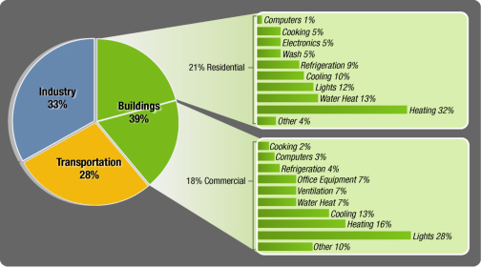
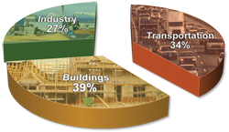
TOTAL CARBON DIOXIDE EMISSIONS
From Energy Consumption by Sector
Source: EESI
Notes:
According to the “Environment and Energy Study Institute” the buildings and transport sectors accounted for 73% of total CO2 emissions in the US in 2014. Many studies have been conducted to analyze emissions from both sectors separately (obviously necessary due to huge impact on overall emissions) but not many have attempted an integrated analysis of the two sectors.
The general case study I used this summer to begin to explore modeling emissions for these two sectors (for both the present and possible future effects based on predictive analysis) is telecommuting. Technology has developed to allow people to communicate and work anywhere at any given time. Examples just at Argonne:
Blue jeans
Box
Remote access to computers. Unlimited access to email.
It’s becoming increasingly evident that working in an office is not necessarily required to be a successful and productive employee. Telecommuting is attractive to employers because flexible work options increases productivity, decreases turnover, improve morale, cost effective (less turnover, less training) and obviously it’s green. Saves employees money and allows a better work/life balance. 3.3 million full-time professionals (excluding volunteers and self-employed) consider their home as their primary place of work. The predominance of telecommuting will likely continue to increase.
It’s evident that telecommuting has the potential to greatly reduce emissions in the transport sector. A large portion of transport is commuting. However the potential impacts to the buildings sector is not so certain. New standards and technology have pushed commercial buildings into being extremely energy efficient. Residential buildings are not nearly as efficient as commercial. With this disparity, and telecommuting causing more people to occupy residential buildings throughout the day, what will be the overall impact on emissions? This is the problem we sought to analyze.

Slide 6
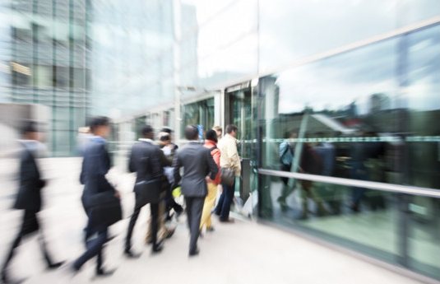
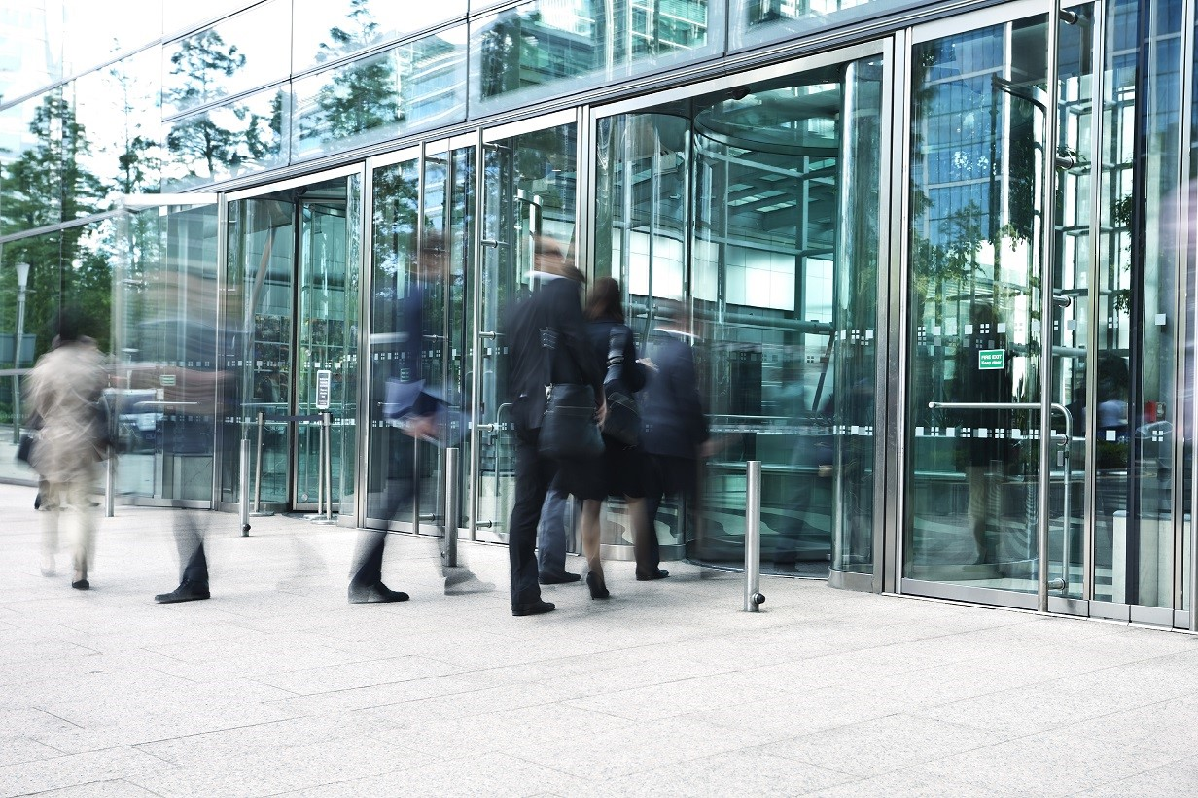
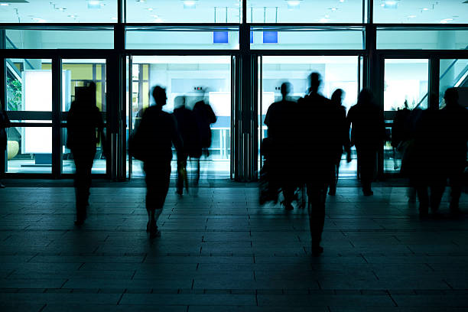
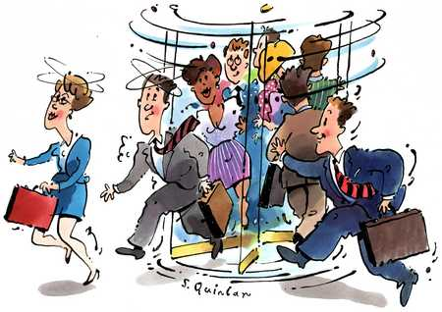
Notes:
When building energy use is studied, one of the most important influences are the occupants. Researchers use data to make estimates about occupancy of buildings but this involves a significant amount of guesswork. With this integrated study, occupancy can be determined directly from outputs of the transportation model so we can have much better estimates of how many people are in each building for each hour of the day.

Slide 7
TELECOMMUTING AND EMISSIONS
Notes:
The general case study I used this summer to begin to explore modeling emissions for these two sectors (for both the present and possible future effects based on predictive analysis) is telecommuting. Technology has developed to allow people to communicate and work anywhere at any given time. Examples just at Argonne:
Blue jeans
Box
Remote access to computers. Unlimited access to email.
It’s becoming increasingly evident that working in an office is not necessarily required to be a successful and productive employee. Telecommuting is attractive to employers because flexible work options increases productivity, decreases turnover, improve morale, cost effective (less turnover, less training) and obviously it’s green. Saves employees money and allows a better work/life balance. 3.3 million full-time professionals (excluding volunteers and self-employed) consider their home as their primary place of work. The predominance of telecommuting will likely continue to increase.

Slide 8
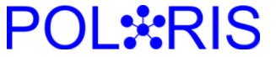
Notes:
Planning and Operations Language for Agent-based Regional Integrated Simulation
Transportation Simulation tool which uses agent-based modeling to predict trips.
The project team consists of two transportation engineers and 3 computational engineers.
give developers tools which will ease their model development eﬀorts, however do not force them to be used. (scenario manager)

Slide 9
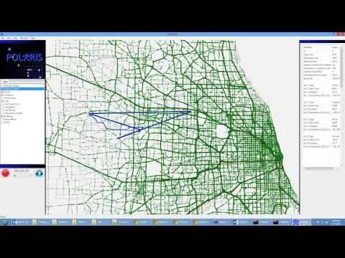
POLARIS: Overview
Agent-based transportation model
Notes:
#Start video at about 3:50 and let play while I talk. Speak to the fact that this not what POLARIS looks like when I am using it. First explain agent based modeling and how the video shows highlighting of individual routes
POLARIS is a transportation systems modeling suite created by the TRACC department (Transportation Research and Analysis Computing Center) here at Argonne. POLARIS is Agent-Based meaning the simulation is modeled based on individual behaviors and decisions, as well dynamic route planning- so individuals may adjust their route or mode based on other individual choices. It can be seen in the video that individuals can be selected and their trips (+details about the trips) will be displayed.
The model was created based on a combination of census data and travel surveys.
Dozens of models have been created that simulate different things separately.
Traffic flow
intersection control
demand generation
operations
However all these things depend greatly on one another so they must be integrated into a single model in order to establish a practical simulation.
We don’t know what the future of transportation will bring, so the model was created with the ability to integrate additional information that may play a role in the future of transportation.

Slide 10
APPLICATIONS
Current and Future
Telecommuting
ITS
Autonomie
Evacuation Planning
Notes:
Dozens of models have been created that simulate different things separately. Traffic flow, intersection control, demand generation, operations. However all these things depend greatly on one another so they must be integrated into a single model in order to establish a practical simulation. Need to be modeled in an integrated manner.
We don’t know what the future of transportation will bring, so the model was created with the ability to integrate additional information that may play a role in the future of transportation.
Scenario manager: set of tools used to define, execute in parallel, & analyze traffic simulation scenarios in terms of conditions such as weather, demand, incidents, and so on. The scenario manager is where I will adjust the model to simulate different telecommuting policies.
Evaluate possible future changes to transportation system, specifically ITS.
In my case, evaluating future impact of telecommuting on traffic as well as building emissions by integrating Ralph’s ISOmodel
Computation of MOEs (measures of effectiveness) for cost/benefit analysis. This way we can determine if the policy is worth implementing. Transportation improvement processes.

Slide 11
APPLICATIONS
Current and Future
Telecommuting
ITS
Autonomie
Evacuation Planning
Notes:
Dozens of models have been created that simulate different things separately. Traffic flow, intersection control, demand generation, operations. However all these things depend greatly on one another so they must be integrated into a single model in order to establish a practical simulation. Need to be modeled in an integrated manner.
We don’t know what the future of transportation will bring, so the model was created with the ability to integrate additional information that may play a role in the future of transportation.
Scenario manager: set of tools used to define, execute in parallel, & analyze traffic simulation scenarios in terms of conditions such as weather, demand, incidents, and so on. The scenario manager is where I will adjust the model to simulate different telecommuting policies.
Evaluate possible future changes to transportation system, specifically ITS.
In my case, evaluating future impact of telecommuting on traffic as well as building emissions by integrating Ralph’s ISOmodel
Computation of MOEs (measures of effectiveness) for cost/benefit analysis. This way we can determine if the policy is worth implementing. Transportation improvement processes.

Slide 12
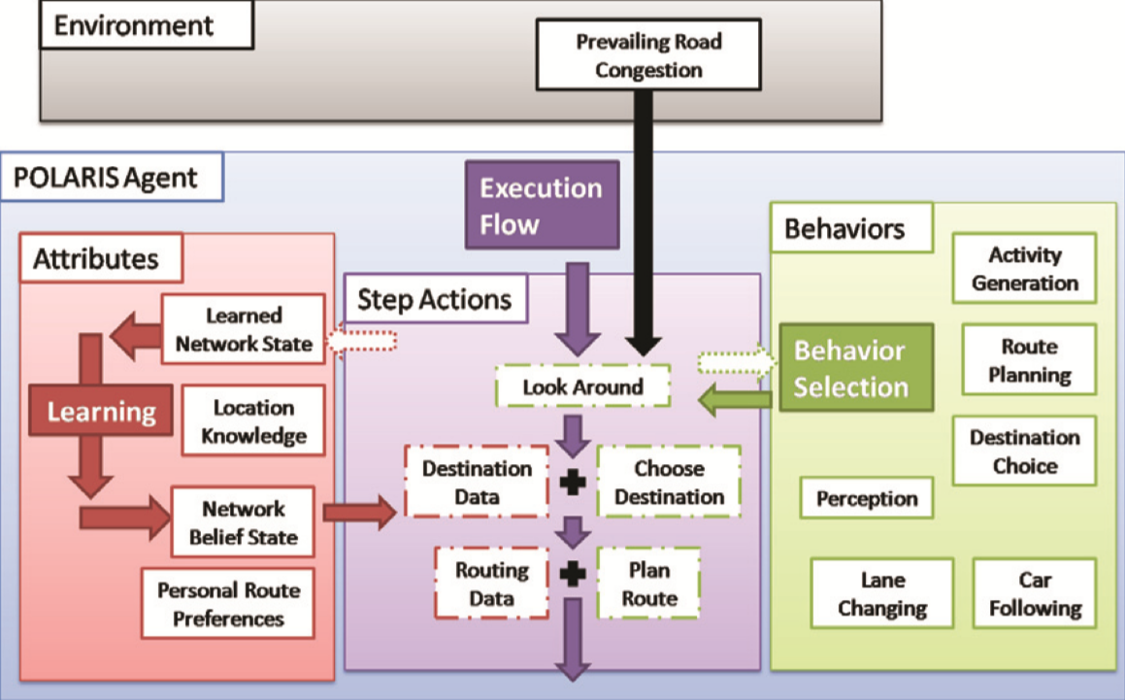
TRAVELER AGENT DESIGN
Notes:
Dozens of models have been created that simulate different things separately. Traffic flow, intersection control, demand generation, operations. However all these things depend greatly on one another so they must be integrated into a single model in order to establish a practical simulation. Need to be modeled in an integrated manner.
We don’t know what the future of transportation will bring, so the model was created with the ability to integrate additional information that may play a role in the future of transportation.
Scenario manager: set of tools used to define, execute in parallel, & analyze traffic simulation scenarios in terms of conditions such as weather, demand, incidents, and so on. The scenario manager is where I will adjust the model to simulate different telecommuting policies.
Evaluate possible future changes to transportation system, specifically ITS.
In my case, evaluating future impact of telecommuting on traffic as well as building emissions by integrating Ralph’s ISOmodel
Computation of MOEs (measures of effectiveness) for cost/benefit analysis. This way we can determine if the policy is worth implementing. Transportation improvement processes.

Slide 13
APPLICATIONS
Current and Future
Telecommuting
ITS
Autonomie
Evacuation Planning
Notes:
Dozens of models have been created that simulate different things separately. Traffic flow, intersection control, demand generation, operations. However all these things depend greatly on one another so they must be integrated into a single model in order to establish a practical simulation. Need to be modeled in an integrated manner.
We don’t know what the future of transportation will bring, so the model was created with the ability to integrate additional information that may play a role in the future of transportation.
Scenario manager: set of tools used to define, execute in parallel, & analyze traffic simulation scenarios in terms of conditions such as weather, demand, incidents, and so on. The scenario manager is where I will adjust the model to simulate different telecommuting policies.
Evaluate possible future changes to transportation system, specifically ITS.
In my case, evaluating future impact of telecommuting on traffic as well as building emissions by integrating Ralph’s ISOmodel
Computation of MOEs (measures of effectiveness) for cost/benefit analysis. This way we can determine if the policy is worth implementing. Transportation improvement processes.

Slide 14
ISOMODEL

Slide 15

ISOModel
Building Energy Model

Slide 16
DATA ANALYSIS

Slide 17
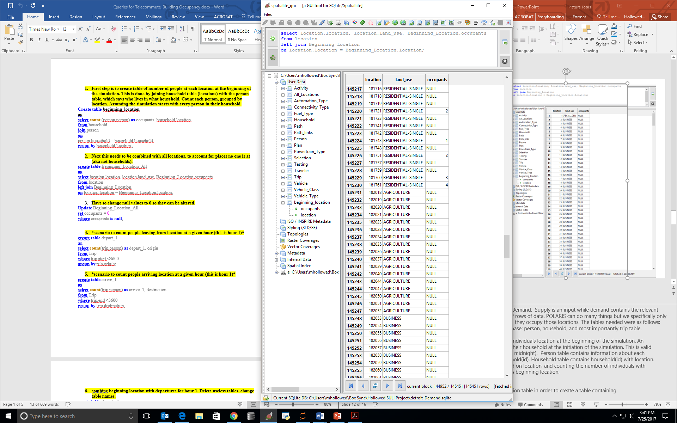
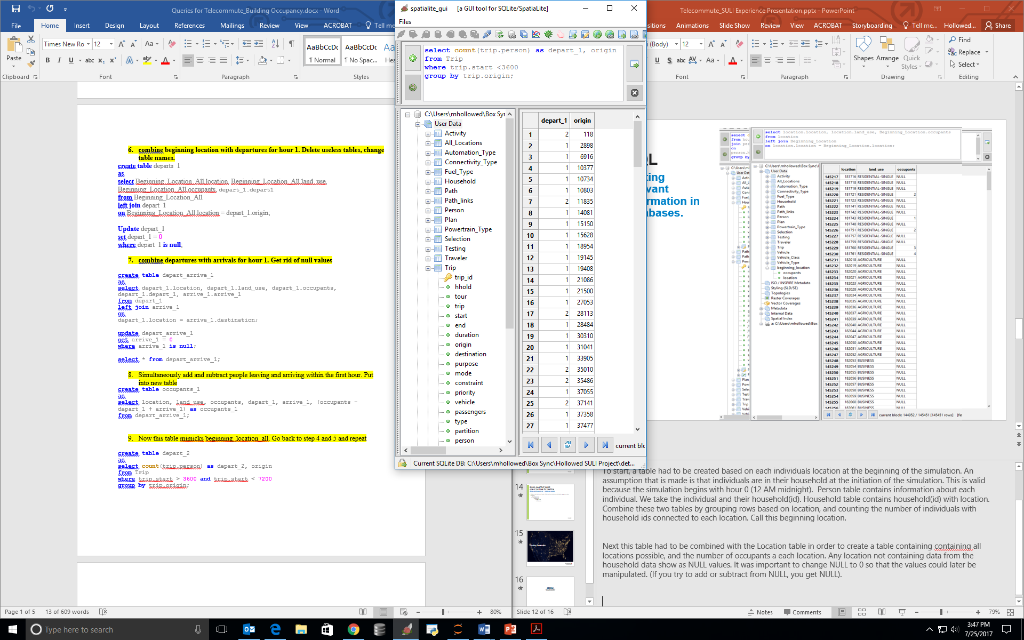
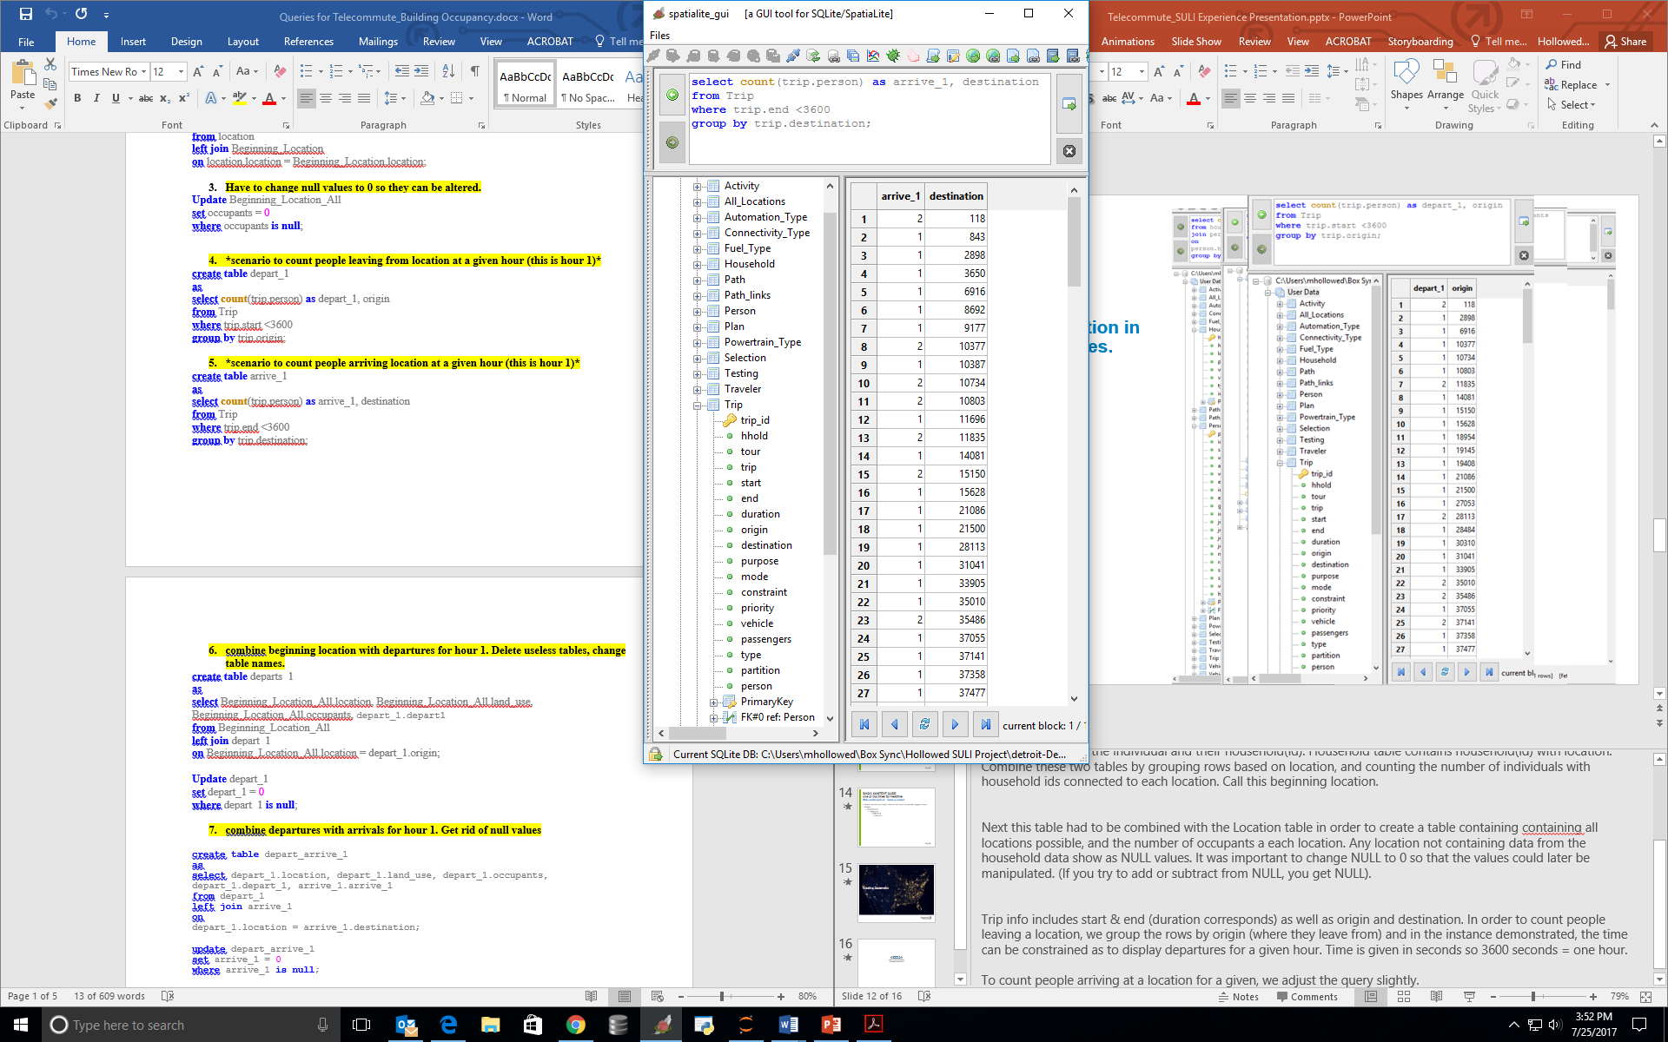
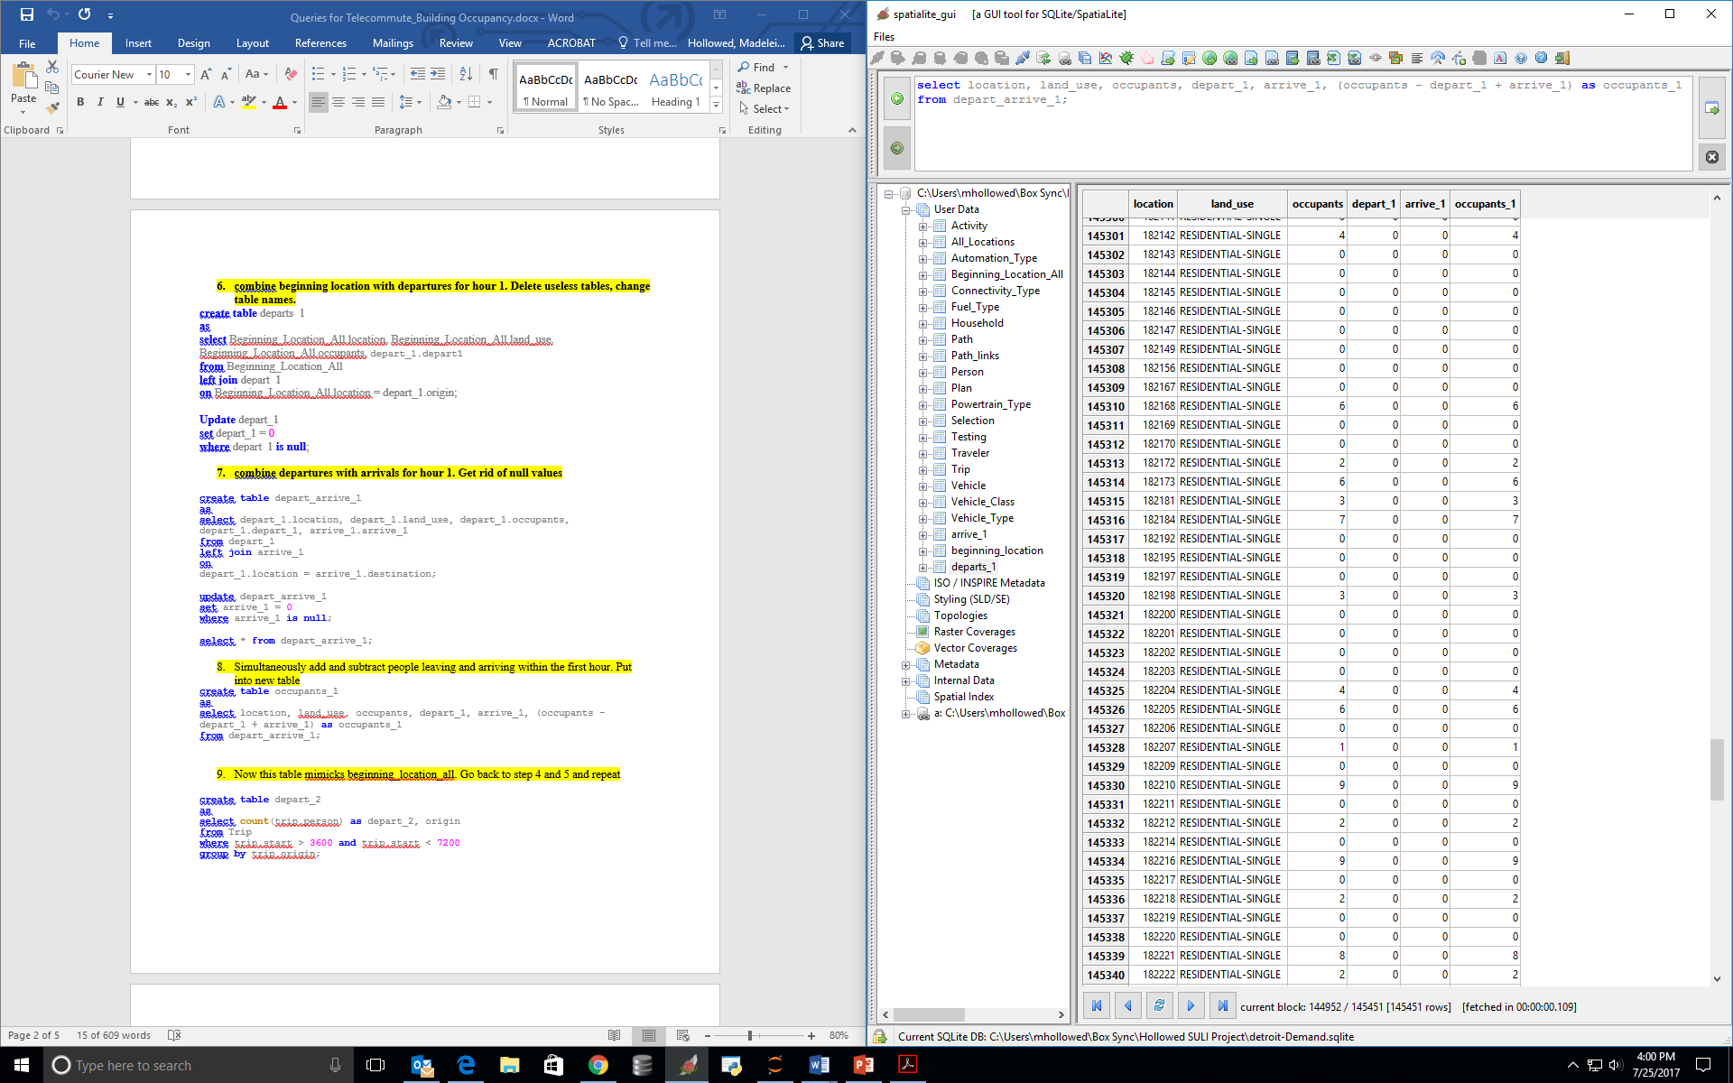
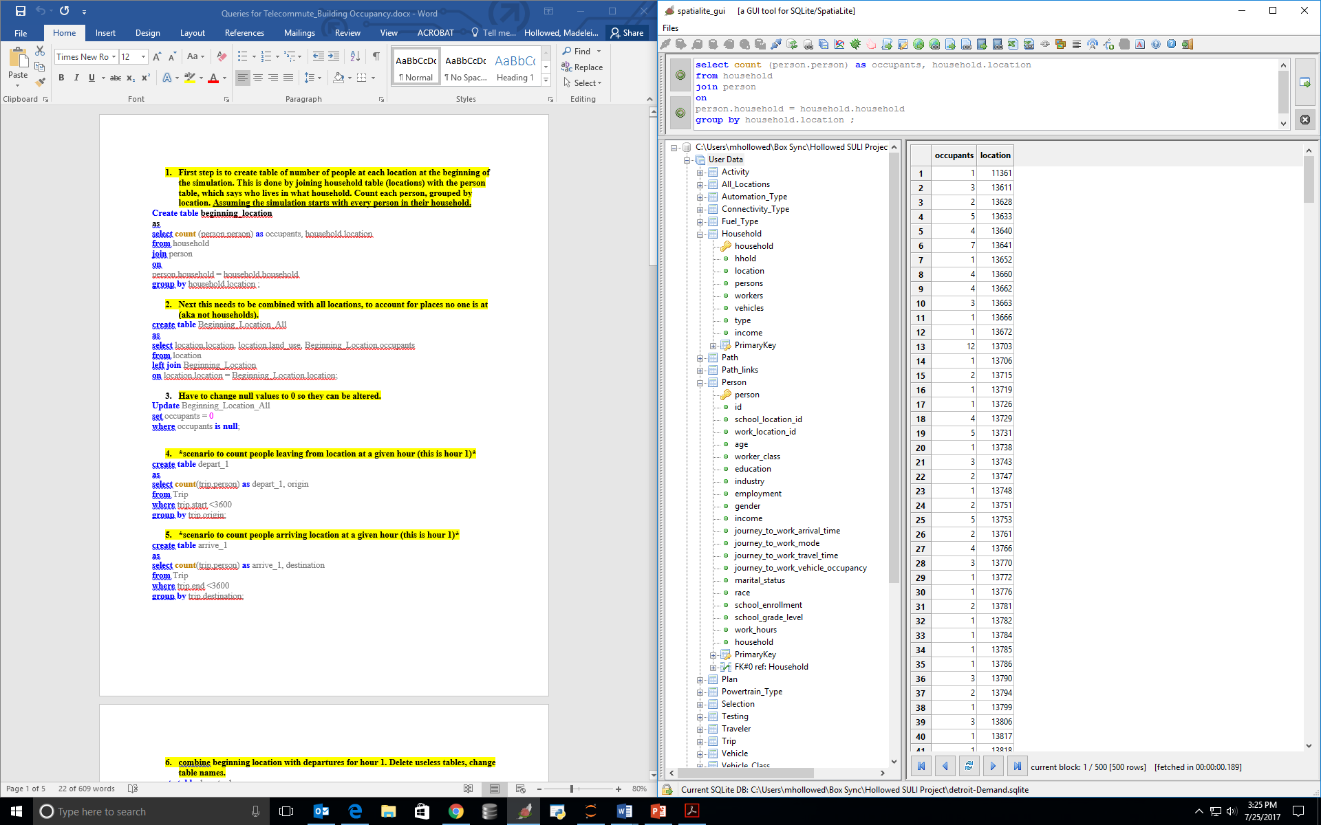
SQL
Sorting relevant information in databases.
Notes:
Outputs from running POLARIS include Supply & Demand. Supply is an input while demand contains the relevant output. Probably over 30 tables with thousands of rows of data. POLARIS can do many things but we specifically only needed to know the locations of people and when they occupy those locations. The tables needed were as follows: from the supply database: location. Demand database: person, household, and most importantly trip table.
To start, a table had to be created based on each individuals location at the beginning of the simulation. An assumption that is made is that individuals are in their household at the initiation of the simulation. This is valid because the simulation begins with hour 0 (12 AM midnight). Person table contains information about each individual. We take the individual and their household(id). Household table contains household(id) with location. Combine these two tables by grouping rows based on location, and counting the number of individuals with household ids connected to each location. Call this beginning location.
Next this table had to be combined with the Location table in order to create a table containing containing all locations possible, and the number of occupants a each location. Any location not containing data from the household data show as NULL values. It was important to change NULL to 0 so that the values could later be manipulated. (If you try to add or subtract from NULL, you get NULL).
Trip info includes start & end (duration corresponds) as well as origin and destination. In order to count people leaving a location, we group the rows by origin (where they leave from) and in the instance demonstrated, the time can be constrained as to display departures for a given hour. Time is given in seconds so 3600 seconds = one hour.
To count people arriving at a location for a given, we adjust the query slightly. Now we need the destination, and for the trip to end within the first hour. The values in arrive_1 demonstrate the number of individuals arriving at the given location.
Different joins are utilized to combine table and then a new column is created titled occupants_1 which is created from adding people who arrived, subtracting people who left, from original occupancy.
The departures and arrivals per hour can be calculated and merged into this table by repeating similar queries.

Slide 18
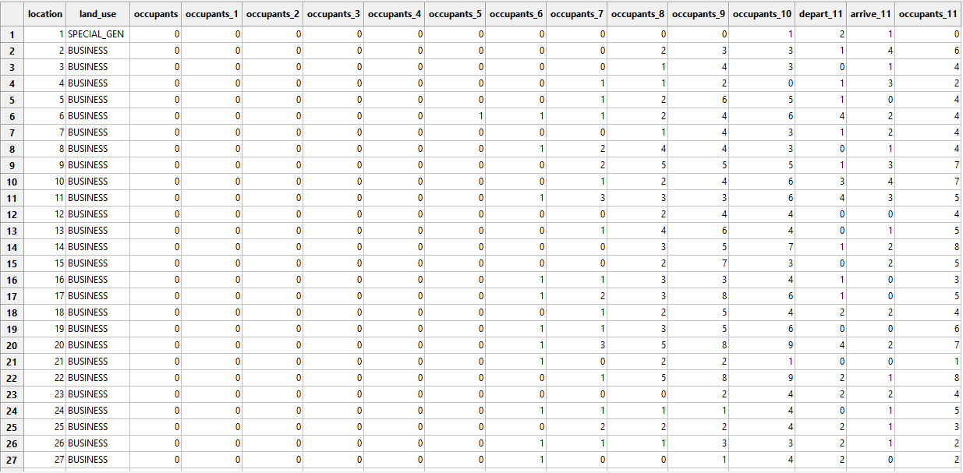
Notes:
This is a table displaying a general summary up until hour 11, including the departures and arrivals for just that hour. At this point I realized I figured out the proper pattern for querying and I was instructed to write a python code that could do this for me. (Yes querying was time consuming. I saved all code in word doc for easy copy pasting.)

Slide 19
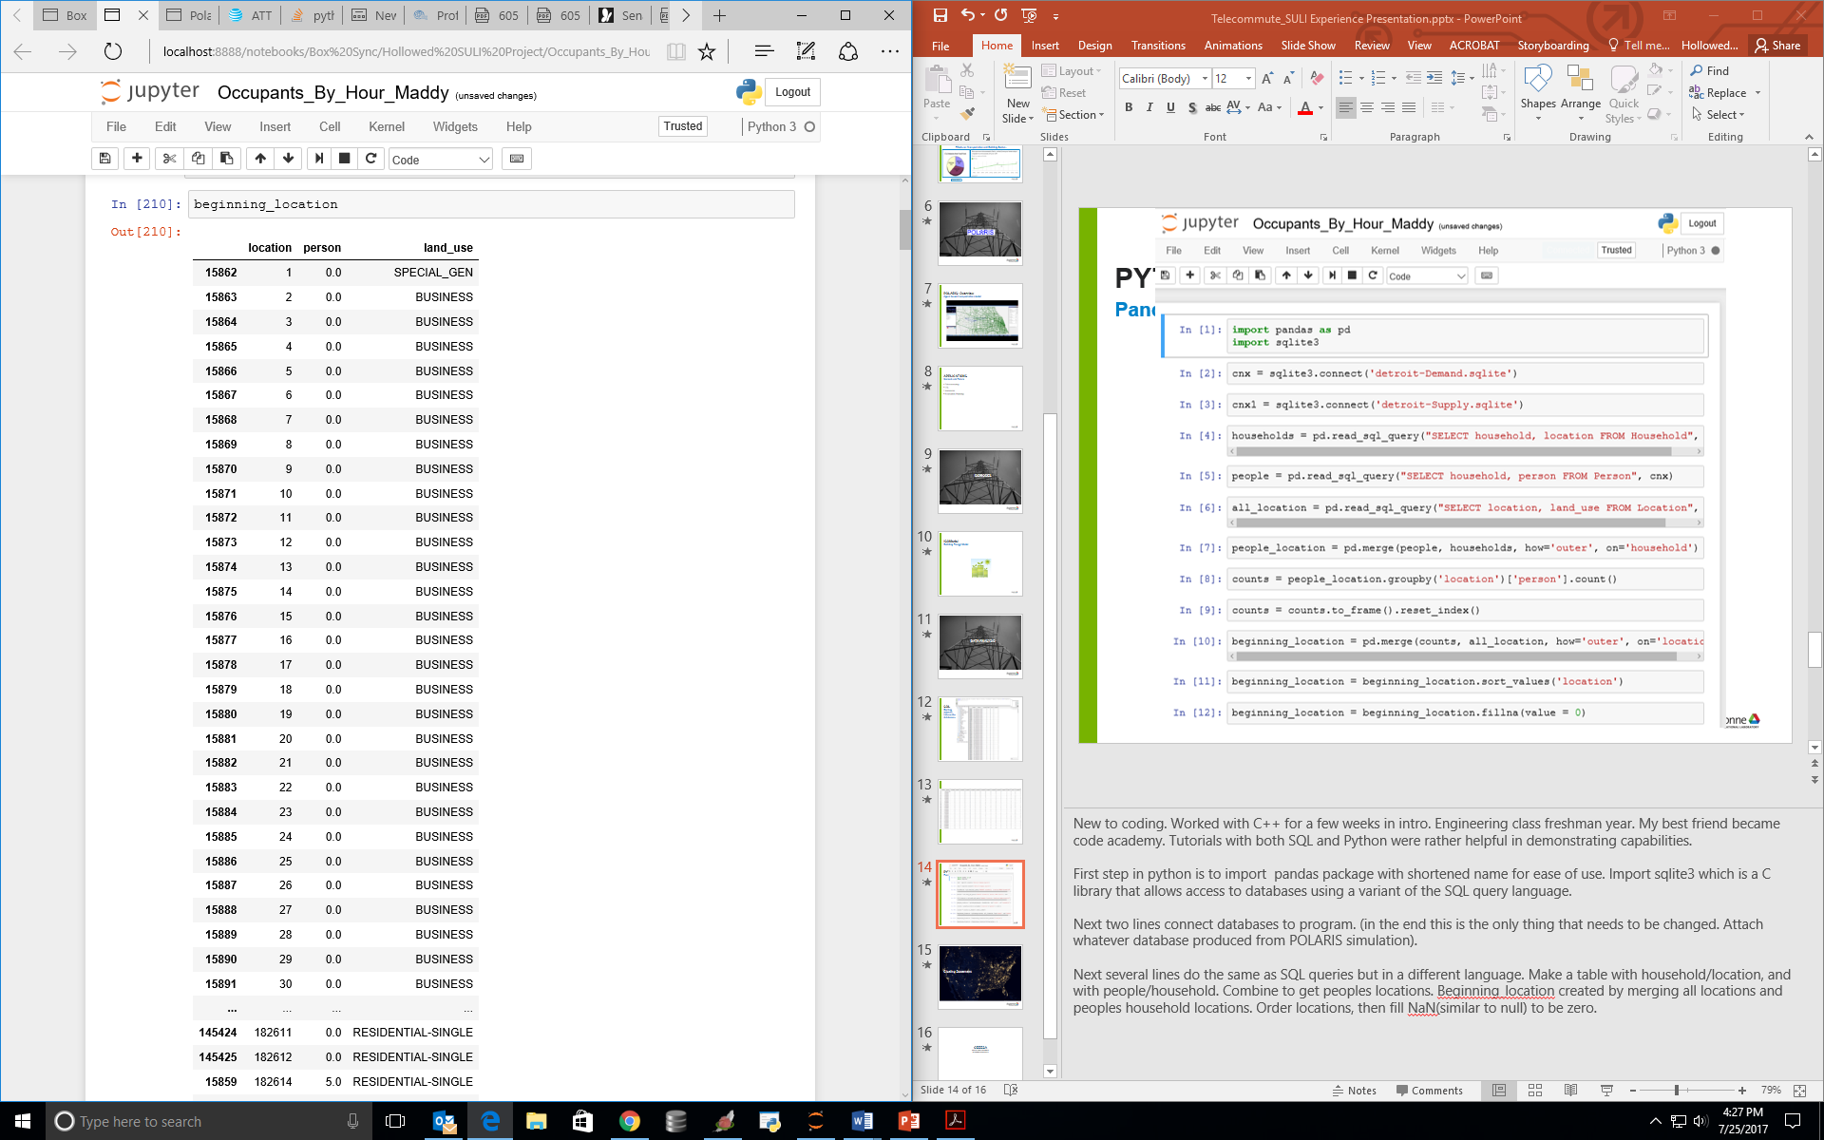
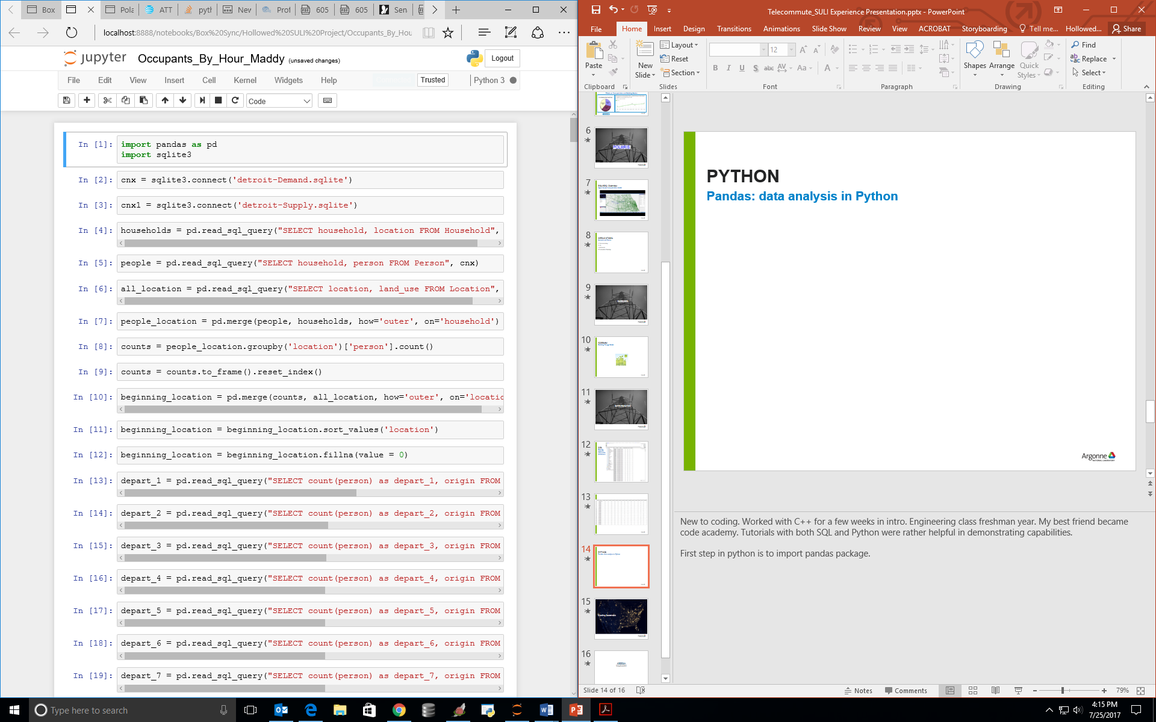
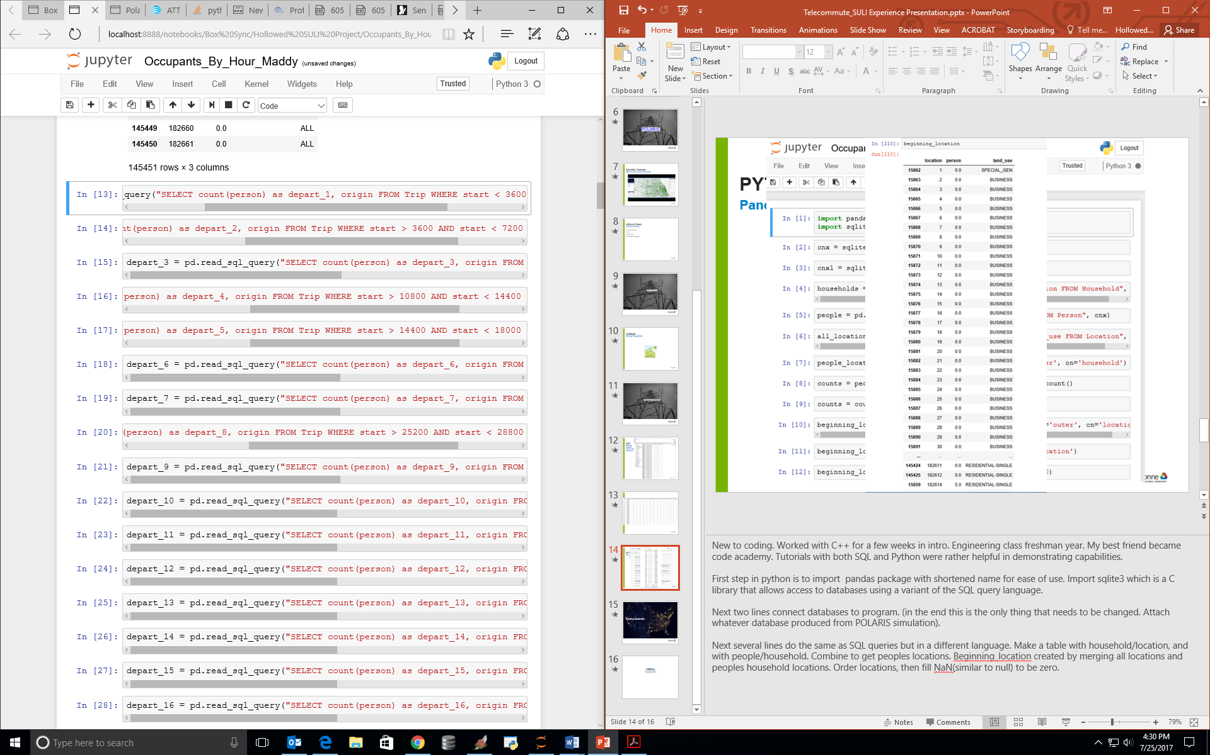
PYTHON
Pandas: data analysis in Python
Notes:
New to coding. Worked with C++ for a few weeks in intro. Engineering class freshman year. My best friend became code academy. Tutorials with both SQL and Python were rather helpful in demonstrating capabilities.
First step in python is to import pandas package with shortened name for ease of use. Import sqlite3 which is a C library that allows access to databases using a variant of the SQL query language.
Next two lines connect databases to program. (in the end this is the only thing that needs to be changed. Attach whatever database produced from POLARIS simulation).
Next several lines do the same as SQL queries but in a different language. Make a table with household/location, and with people/household. Combine to get peoples locations. Beginning_location created by merging all locations and peoples household locations. Order locations, then fill NaN(similar to null) to be zero.

Slide 20
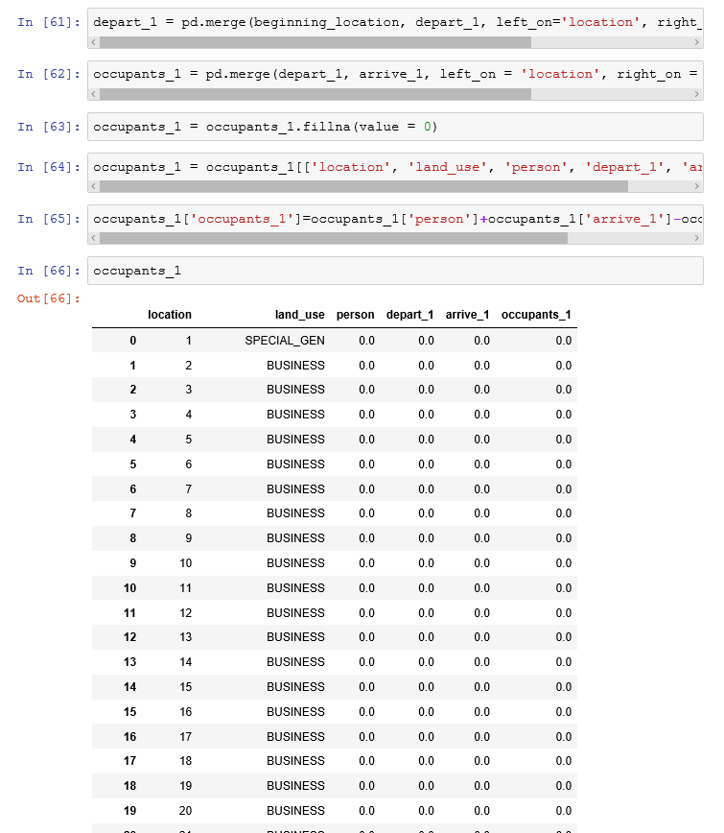
occupants_1['occupants_1'] =
occupants_1['person'] + occupants_1['arrive_1'] - occupants_1['depart_1']
Notes:
Next merged beginning locations with departures, created occupants_1 from previous merge and arrivals. Filled in zeros. Updated occupants_1 to contain only the columns shown. Those are the relevant ones (also some duplicates from merging- again im not super proficient).
These five lines of code were repeated adjusting each time to combine the next hours data until 24 hours of data is created. Again, lots of repeat in code and I hope to spend my last week condensing that code. But the good thing is that this code can produce what we need just by connecting the appropriate databases.

Slide 21
Closing Statement

Slide 22
CEEESA
Center for Energy, Environmental,
and Economic Systems Analysis

